Slide 1

FACULTY OF INFORMATION TECHNOLOGY
Hotel Reservation System

Slide 2
Presented by: Omar Mohamed & Ayham Ahmed & Mahmoud Hamza & Hamdy Mohamed
Supervised by: Dr/Esmat Mohamed

Slide 3

Agenda
Introduction
Possible Beneficiaries
Main Objectives
Related Works
Problem Definition
Proposed System
System Architecture
Methodologies and Techniques
System Requirements (S/W and H/W Tools)
Results and Outcomes
Conclusion
References

Slide 4
Introduction

Slide 5
Introduction
Traveling is an experience that can enrich our lives, whether it's for business or pleasure. However, finding the perfect hotel can sometimes be a challenge. That's why we've created a website that makes booking hotels easier and more convenient than ever before. Our website offers a variety of features that allow you to search and compare hotels from around the world, making it easier for you to find the perfect place to stay.
In this presentation, We'll be sharing with you more about our website, its benefits, and how it can help you book your next hotel stay seamlessly. So, let's dive in and explore our website together.

Slide 6
Possible Beneficiaries

Slide 7
Possible Beneficiaries
Travelers: The primary beneficiaries of a hotel booking website are travelers who are looking for a place to stay during their trip. The website allows them to search for hotels based on their preferences, such as location, price, amenities, and reviews, and make reservations online.
2.Hotel owners and managers: Hotel owners and managers can benefit from a hotel booking website by having a platform to showcase their properties and attract more guests. They can also use the website to manage their bookings, rates, and availability.
3.Local communities: Local communities can benefit from a hotel booking website by attracting more tourists to their area, which can boost the local economy and create job opportunities.

Slide 8
Main Objectives

Slide 9
Main Objectives
To create an easy-to-use interface for hotel administrators to add and update hotel offers, manage reservations, and oversee the booking process effectively.
To optimize the system's performance, scalability, and responsiveness to handle multiple users and simultaneous reservations efficiently.
To implement a robust and secure database system that stores hotel information, user details, and reservation data securely.

Slide 10
Related Works

Slide 11
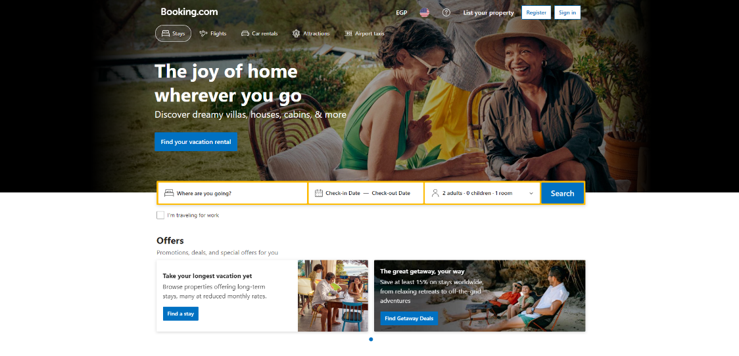
Related Works
Booking
A place to browse and save beautiful photos of inspiring homes. A place to find and hire the right design and construction professionals.
A place to connect with others who have been there too. What started as a side project has now grown to a community of millions of homeowners, home design enthusiasts and home improvement professionals around the world.

Slide 12
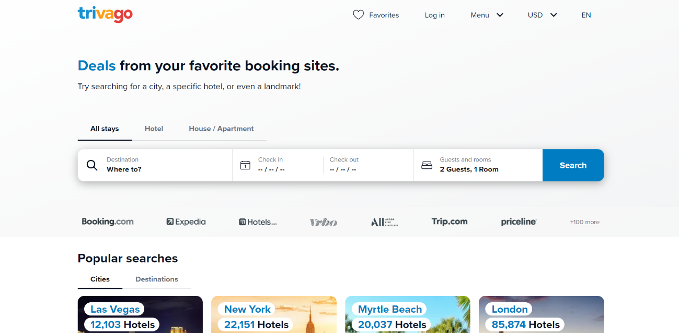
Related Works
Trivago
Trivago.com serves as a metasearch engine for hotels, aggregating information from numerous booking sites and hotel providers. Its primary focus is to simplify the hotel search process by presenting users with a consolidated view of available options, enabling them to make informed decisions based on factors like price, location, amenities, and user reviews.

Slide 13
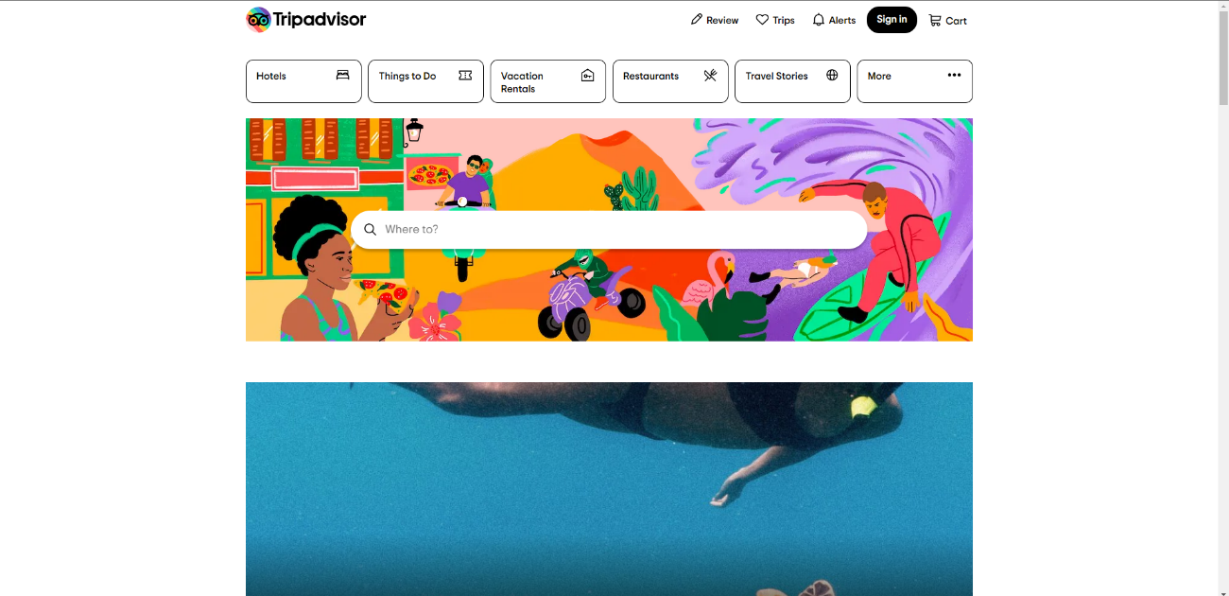
Related Works
TripAdvisor
Tripadvisor.com serves as a comprehensive resource for travelers, offering a platform where users can access a wide range of travel-related information, reviews, and recommendations. It aims to empower travelers with insights and advice from fellow travelers, helping them plan and book their trips with confidence.

Slide 14
Problem Definition

Slide 15
Problem Definition
In the traditional hotel booking process, both hotel administrators and users face various challenges. Administrators often struggle with manual record-keeping, maintaining updated hotel information, and managing reservations efficiently. On the other hand, users encounter difficulties in finding suitable accommodations, making reservations, and accessing their booking history easily. These challenges can lead to inefficiencies, miscommunications, and inconvenience for both parties involved.

Slide 16
System architecture

Slide 17
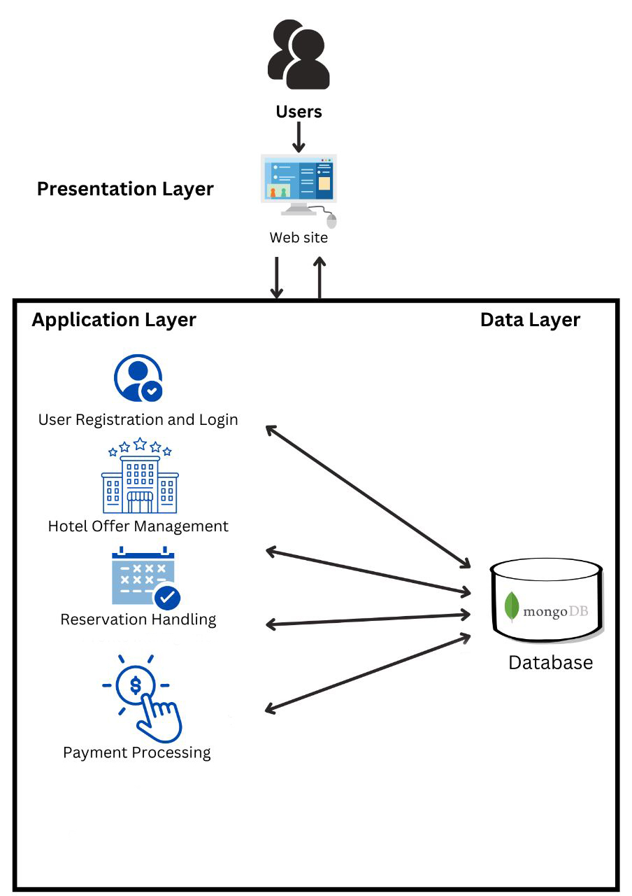
System Architecture
Our System architecture for this project :

Slide 18
Methodologies and Techniques

Slide 19
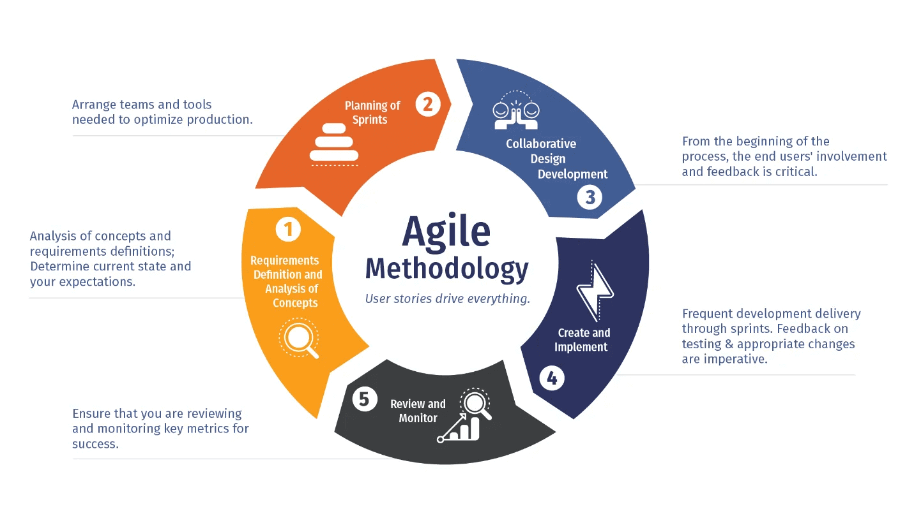
Methodologies and Techniques
Agile Methodology
The Agile methodology is a project management approach that involves breaking the project into phases and emphasizes continuous collaboration and improvement. Teams follow a cycle of planning, executing, and evaluating.

Slide 20
Methodologies and Techniques
Agile Methodology’s Advantages:
Iterative and incremental development: Agile methodology emphasizes iterative and incremental development, which means that the project is divided into smaller chunks or sprints that are completed in a short period of time. This allows for continuous feedback and improvement and ensures that the project stays on track.
Flexibility and adaptability: Agile methodology is known for its flexibility and adaptability, which means that the project can respond to changing requirements, priorities, and market conditions. This is particularly important in the fast-paced and dynamic environment of the travel industry, where customer demands and preferences can change rapidly.

Slide 21
System Requirements (S/W and H/W Tools)

Slide 22
System Requirements (S/W and H/W Tools)
Software:
Visual Studio
git, GitHub
JavaScript
Node.js
React
MongoDB Compass
Hardware:
PC

Slide 23
Results and Outcomes

Slide 24
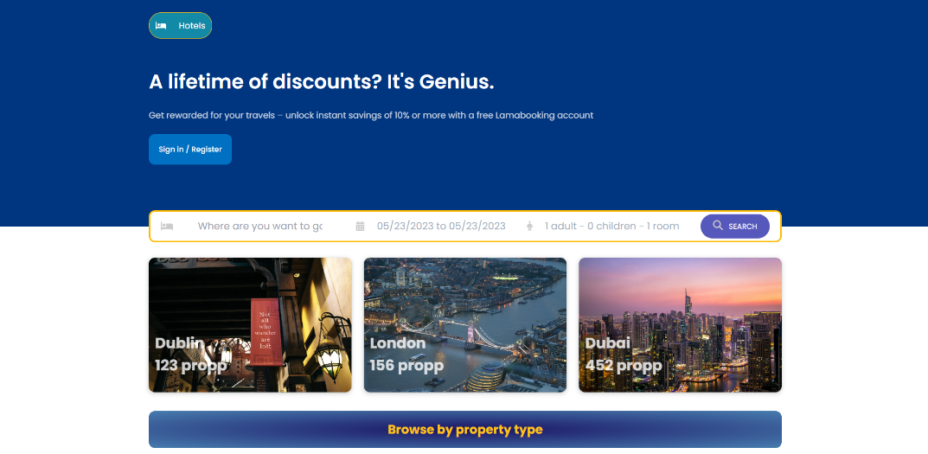
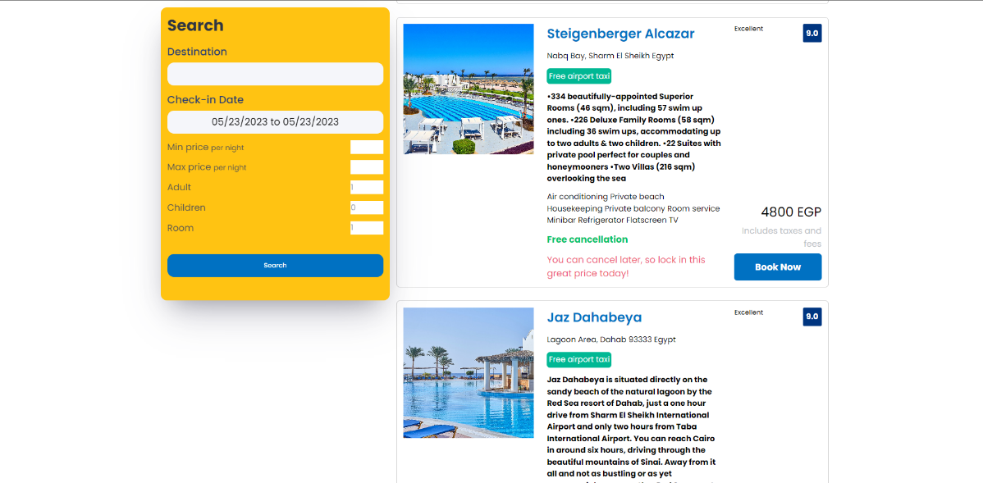
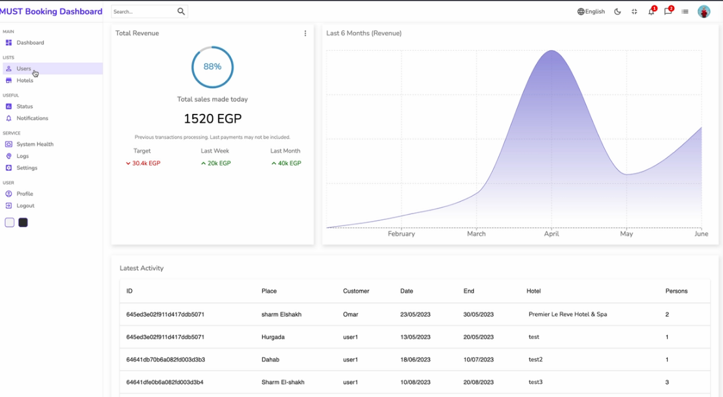
Results and Outcomes

Slide 25
Conclusion

Slide 26
Conclusion
In conclusion, the hotel booking project represents a significant step forward in the digitalization of the hospitality industry. By providing a user-friendly platform for customers to browse and book hotel rooms, the project streamlines the booking process and improves the overall customer experience.
The project also offers a range of benefits for hotel owners and managers, including automated booking management and the ability to reach a wider audience of potential customers. The project's use of modern technologies and best practices ensures that it is scalable, secure, and easy to maintain.
Overall, the hotel booking project represents a valuable contribution to the hospitality industry, both in terms of improving the customer experience and helping hotels to operate more efficiently. As the project continues to evolve and improve, it has the potential to become an essential tool for hotels of all sizes and types..

Slide 27
References

Slide 28
References
A Review of Online Hotel Booking Systems: Research Issues and Opportunities" by Rob Law and Deqing Wang:
https://www.researchgate.net/publication/220713706_A_Review_of_Online_Hotel_Booking_Systems_Research_Issues_and_Opportunities
Factors Influencing Customers' Intention to Use Online Hotel Booking Systems: Evidence from Saudi Arabia" by Bander Alqahtani:
https://www.emerald.com/insight/content/doi/10.1108/JTF-07-2019-0106/full/html
Analysis of Online Hotel Booking Systems: A Customer Perspective" by Wenchao Zhang and Xudong Gao
https://ieeexplore.ieee.org/abstract/document/8413400
An Investigation of Customer Adoption of Mobile Hotel Booking Systems" by Athina Papadopoulou, Michail Batikas, and Despina Polemi:
https://www.mdpi.com/1996-1073/13/15/4016

Slide 29


